Slide 1


TRIMIND

Slide 2

Members
Ziad Mourssy oun
Hana ahmed elsherif
Howida Ashraf Mostafa

Slide 3

The Problem
the gap between learning and real-world application
Limited Access to Practical Learning
The Ecosystem Gap
A growing gap separates emerging markets from the U.S. and Europe in entrepreneurship, investment, and technology adoption.
People in mature ecosystems have greater exposure to startups, investors, technology communities, and global opportunities — creating a stronger pipeline from learning to building.
The knowledge exists — but access to practical, applied learning is still limited.
Many learners lack affordable access to real-world simulations, experienced mentors, modern tools, and environments where they can safely practice investing, building technology, and running a business.
.The Mindset Gap
One-Size-Fits-All Learning
The Learning-to-Real-World Gap
Education often teaches people to pass — not to build, decide, and take calculated risks.
Traditional learning rarely develops entrepreneurial thinking, investment mentality, technical decision-making, experimentation, or the confidence to turn knowledge into action.
Everyone receives the same learning experience — regardless of who they are or where they want to go.
A learner's background, current skill level, goals, preferred learning style, and career direction are rarely used to create a truly personalized journey.
Knowing the concept is not the same as knowing how to use it.
Learners may understand business, technology, finance, or AI in theory — but lack opportunities to make decisions, experience consequences, learn from mistakes, and build real-world judgment.

Slide 4

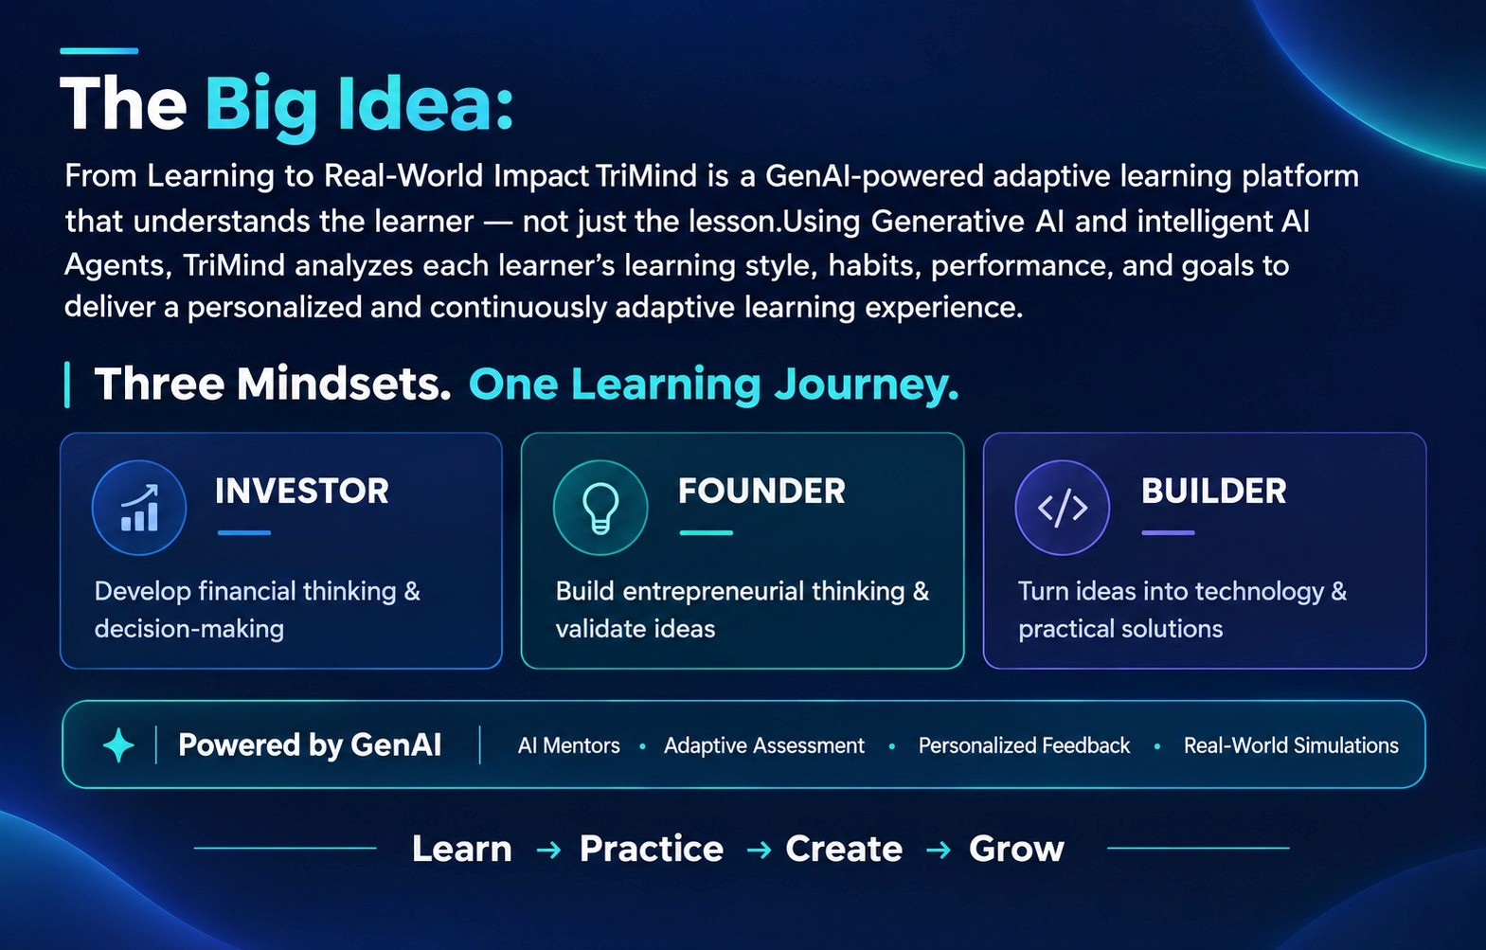

Slide 5
3
learning
paths
  investor mode
  builder mode
  founder mode

Slide 6
01
investor mode
Understand your startup from an investor’s perspective.
Investment Mode helps users look at their business through a financial and investment lens, giving them a clearer understanding of their opportunities, risks, and readiness for funding.
what you learn
  Investment Basics
  Understand the financial side of the business
  Identify key risks and growth opportunities
  Analyze the competitive position of the startup
  Organize key metrics and investment information
  Prepare a stronger foundation for investor discussions
  Risk & Return
  Portfolio Building
  Market & Assets

Slide 7
02
builder mode
Turn your business vision into a real product.
Builder Mode focuses on the practical side of bringing an idea to life. It helps users define their MVP, prioritize features, and organize the steps needed to build and improve their product.
what you learn
  Programming Fundamentals
  Problem Solving
  Define the core features of your MVP
  Prioritize what needs to be built first
  Choose suitable technologies and development approaches
  Break the product into clear, actionable tasks
  Test, learn, and improve through iteration
  AI & Technology
  MVP Building

Slide 8
03
founder mode
what you learn
Turn your idea into a clear business direction.
Founder Mode helps users move beyond the initial idea by understanding the market, identifying their target audience, exploring competitors, and shaping a sustainable business model.
  Business Fundamentals
  Customer Insights
  Validate your idea and understand its market potential
  Identify your target customers and their needs
  Explore competitors and market opportunities
  Define your business model and value proposition
  Build a clear roadmap from idea to launch
  Business Models
  Marketing & Strategy

Slide 9
How students use TRIMIND?
STUDENT JOURNEY
from signing up to becoming a confident decision-maker
CORE JOURNEY
STEP 1: GET STARTED
Pick a Track
STEP 2: LEARN & PRACTICE
Study & Get Tested
Student signs up, sets a goal, and chooses a track — Investment, Founder, or Builder — based on their level and time.
Structured lessons paired with quizzes and reflection questions — graded live by AI, not just multiple choice.
STEP 3: APPLY IT
Simulate Real Decisions
STEP 4: TRACK & GROW
See Real Progress
Practice simulator and 24/7 AI mentor let students test real choices and get instant feedback before it counts for real.
Streaks, achievements, and an AI-generated learning plan adapt automatically as the student improves.

Slide 10
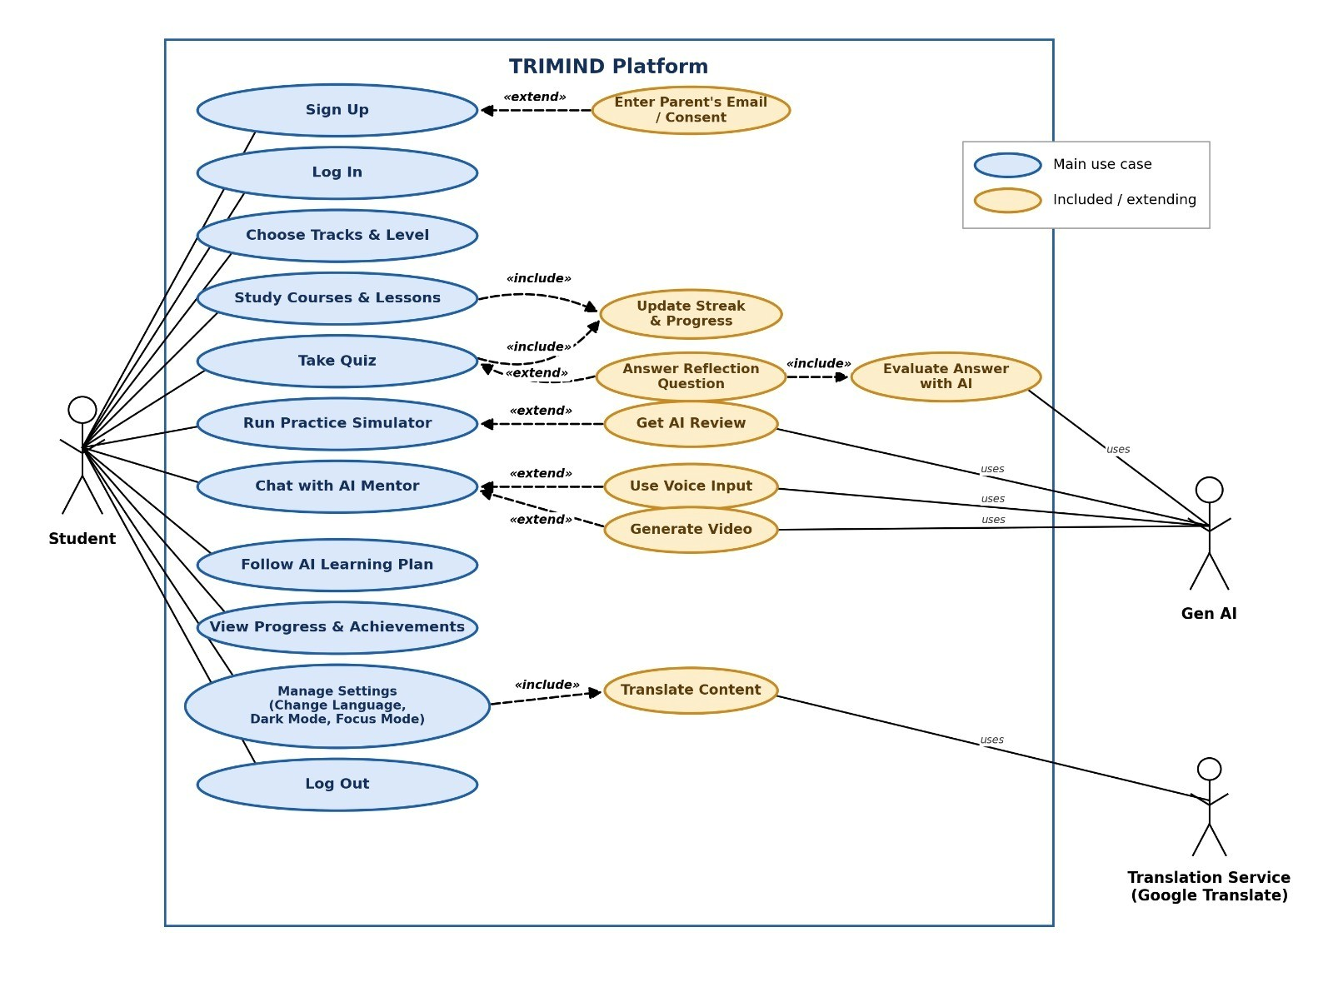
Our usecase:

Slide 11
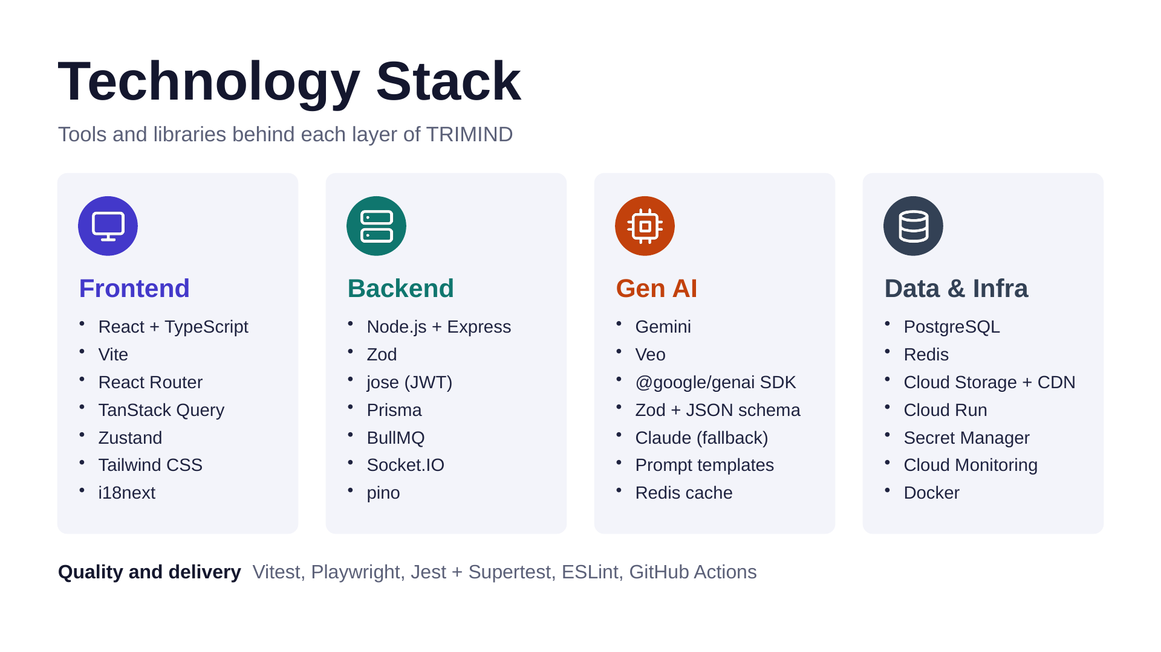
Architecture & Workflow

Slide 12
5
Gen ai
features
  AI Assessment Revolution
  Learning Journey and Content Plan Generation
  Gen AI Models for Prompting and Video Generation
  Interactive Gen AI Simulators
  AI Mentor (Chatbot, Voice Agent, RAG System)

Slide 13
AI Assessment Revolution
Understand Your Learning Style & Build Your Tailored Curriculum
Most learning platforms treat every student the same way — one fixed pace, one generic path. TRIMIND flips that script. In just 3 minutes, our 3-Tier AI diagnostic profiles you across 5 core dimensions — domain knowledge, reasoning style, preferred modalities, study pace, and metacognitive calibration — then builds a curriculum that's genuinely yours from day one. No wasted lessons, no mismatched pace: just a learning journey engineered around how you actually think and learn.
3
5
20
3 min
Tiers
Core Dimensions
Questions
To Complete
Start 3-Min AI Assessment

Slide 14
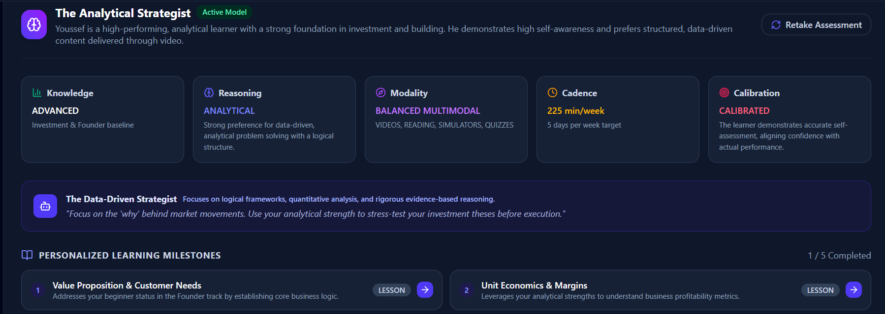
02
Learning Journey and Content Plan Generation
An intelligent AI system that analyzes each user’s goals, interests, skill level, and learning progress to generate a structured and personalized content plan. It continuously adapts the learning path by recommending relevant topics, resources, and next steps to help users achieve their objectives efficiently.

Slide 15
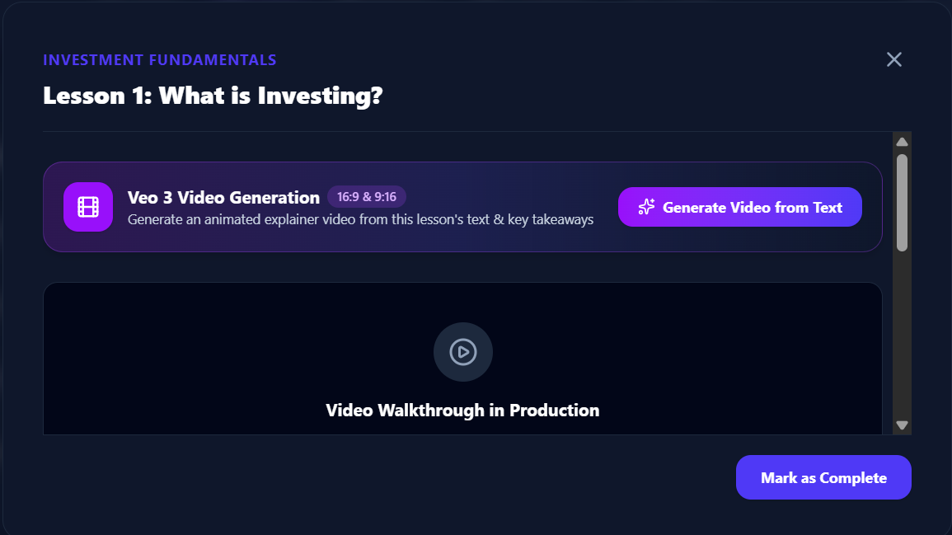
04
Gen Ai models for prompt and video generation
TRIMIND transforms simple user prompts into engaging, AI-generated educational videos. Users can describe a topic, concept, or idea they want to explore, and the system generates visual content designed to make complex business, investment, entrepreneurship, and technology concepts easier to understand. This feature provides a more interactive and personalized learning experience while allowing users to learn through visual content tailored to their interests and needs.

Slide 16
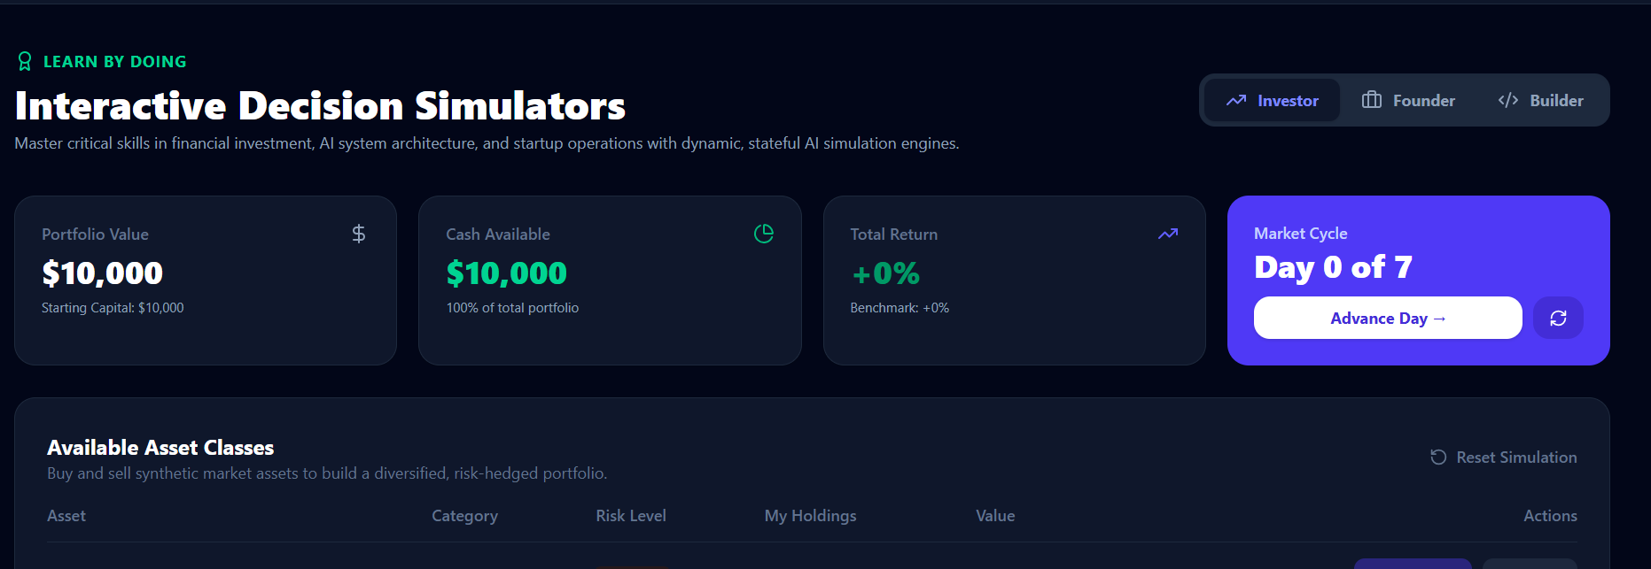
05
Interactive Ai Simulators
Real-world simulations that allow users to practice decision-making in different scenarios:
  Investment Simulator : Practice investment decisions and explore potential outcomes.
  Startup Simulator : Experience the process of building and managing a startup.
  Business Simulator : Make strategic business decisions and see their impact.

Slide 17




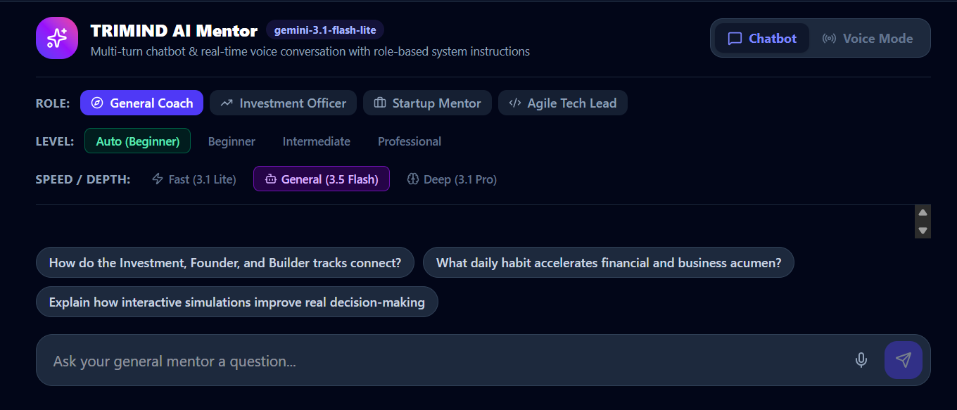


03
AI mentor
An AI-powered mentor that interacts with users through Arabic and English voice and chat, providing personalized explanations, answering questions, recommending learning resources, and adapting its guidance to each user’s goals, level, and progress.RAG systems for each mode and level

Slide 18
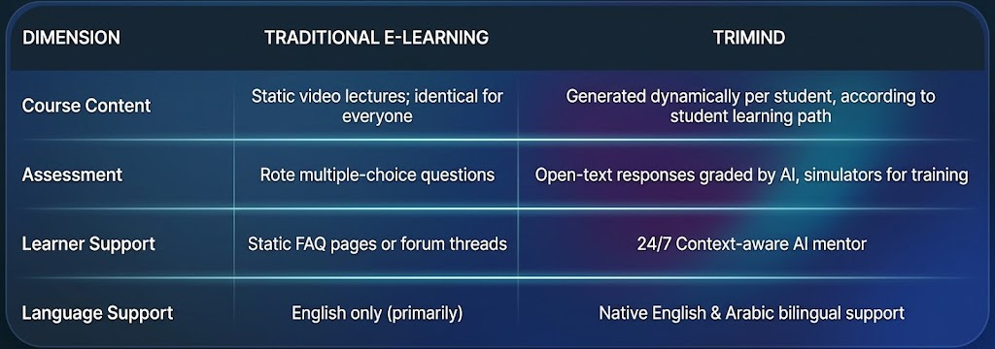
Why It Matters?

Slide 19
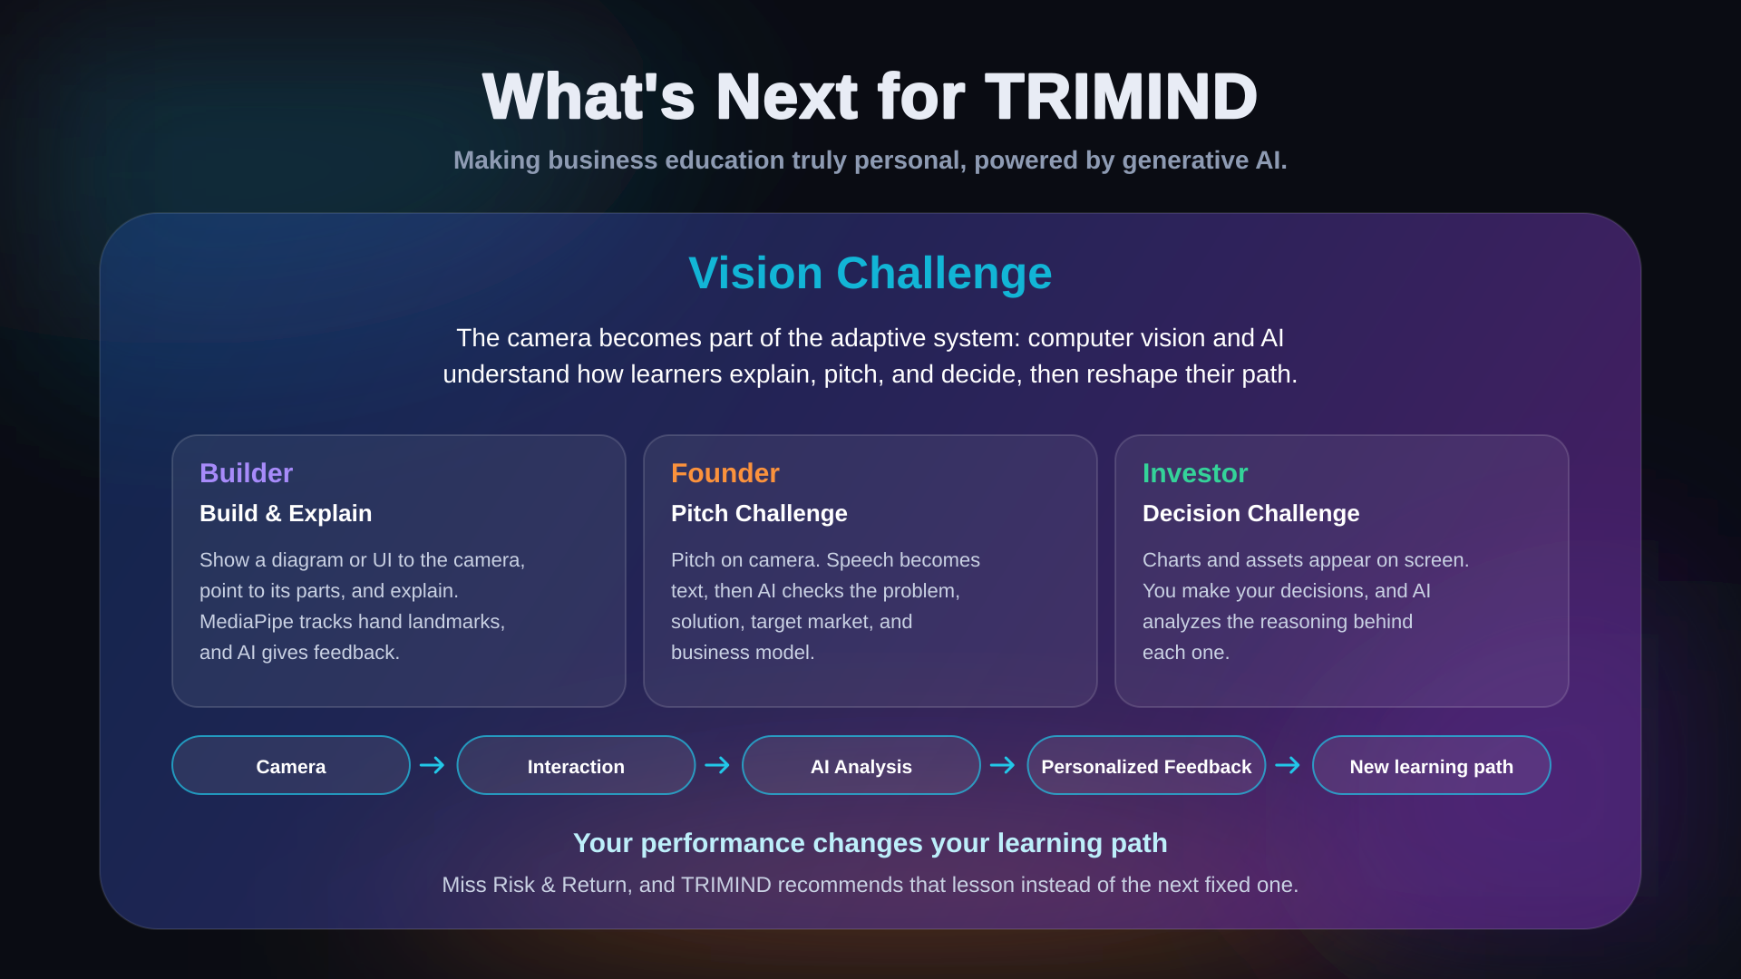

Slide 20




What's Next for TRIMIND
Making business education truly personal , powered by generative AI.
Eductional & Academic
  DEPI,DEMI
  ITI,NTI
  Tech Schools
  Universities
  نظام البكالوريا للثانوية العامة
These organizations share a similar approach to TRIMIND, focusing on practical, personalized, and technology-driven learning. This creates opportunities for future partnerships, collaboration, and expanding our educational impact

Slide 21



What's Next for TRIMIND
Making business education truly personal , powered by generative AI.
investment

Slide 22
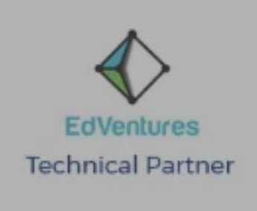



What's Next for TRIMIND
Making business education truly personal , powered by generative AI.
Entrepreneurship

Slide 23




What's Next for TRIMIND
Making business education truly personal , powered by generative AI.
AI and tech

